Slide 1


Chapter 5:
Results Analysis and Safety Implications
Core Agenda: Deep Dive into Feature Impact, Data Quality & Safety Guidelines
Presenter:ZiXuan Wang
Notes:
In Chapter 5, we will delve into the results of our analysis and discuss their implications for safety.

Slide 2
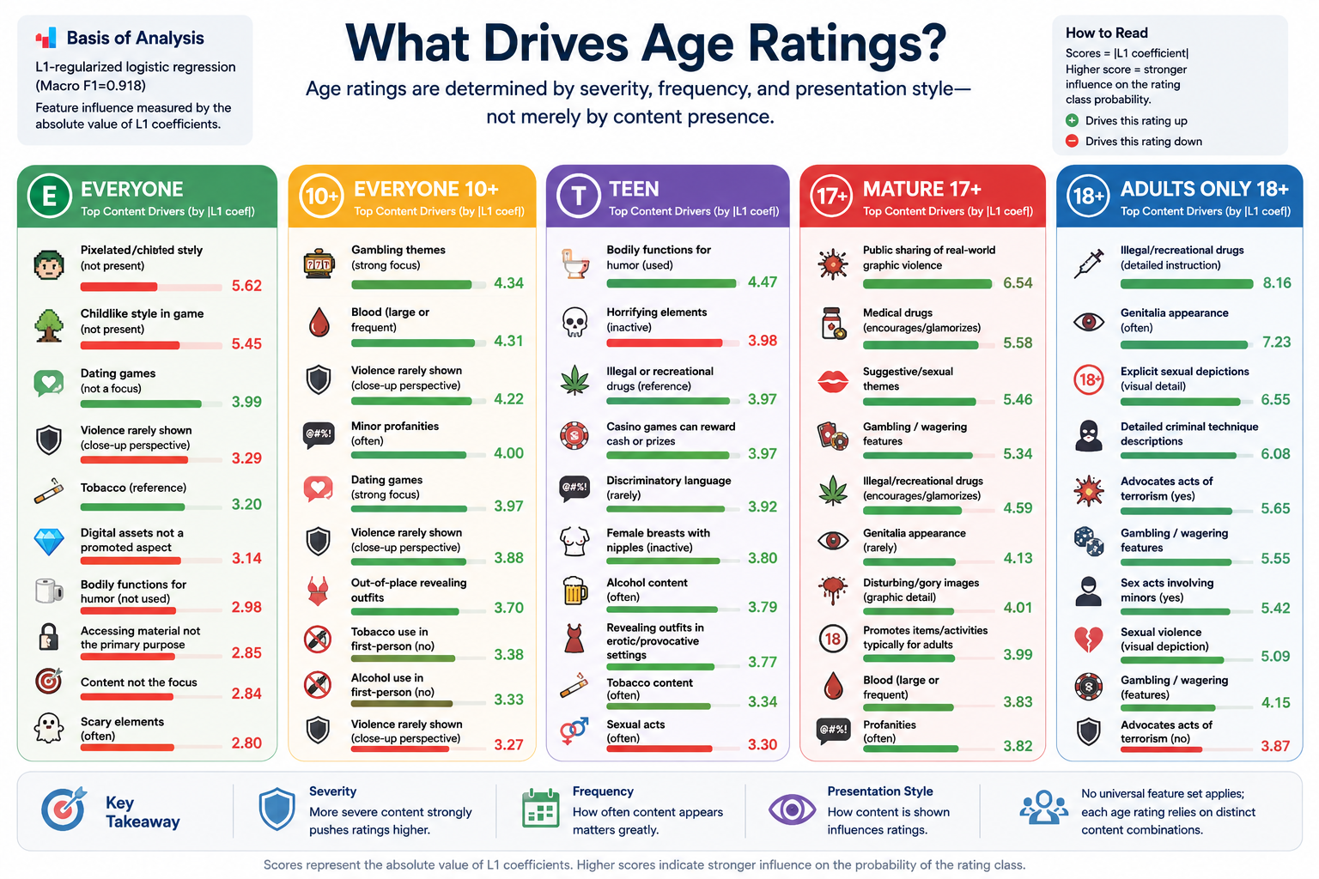
Notes:
Our analysis is based on the L1-regularized logistic regression model, which performed best in Chapter 4. By examining the model's coefficients, we can see which features most strongly influence each age rating.
This slide shows that different age ratings are driven by different content patterns. Lower ratings are mainly influenced by lighter signals such as visual style, mild violence, gambling themes, and minor profanity. As the rating increases, the key drivers become more severe and explicit, including drug references, graphic violence, sexual themes, gambling, criminal techniques, and sexual violence. The main takeaway is that age classification depends not only on whether content exists, but also on its severity, frequency, and presentation style.

Slide 3
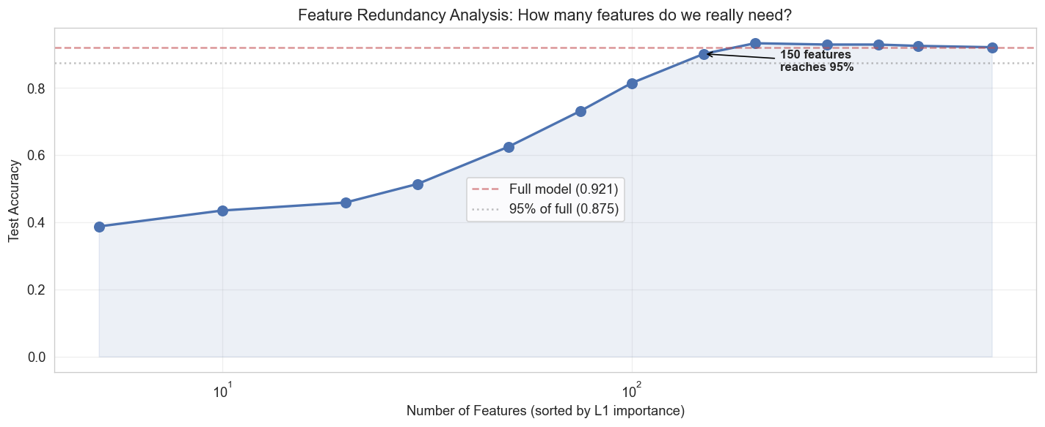
Questionnaire Redundancy:
More Questions Do Not Always Improve Performance
📈 Experimental Findings
Tested feature subsets (10, 50, 200, 758). Accuracy rose sharply to 200 features (0.933, 101% relative to full), then slightly declined with all 758 features, proving diminishing returns and redundancy.
💡 Key Conclusion
The Google Play questionnaire contains substantial redundancy. Most items provide little discriminative value, and using a subset of 200 high-information features is sufficient to match or exceed the performance of the complete dataset.
Peak Accuracy (200 Feat)
0.933
Full Model (758 Feat)
0.921
🎯 Practical Implications
Prioritize high-density features for research; simplify questionnaires to boost user completion efficiency and reduce data collection costs.
💡Insight: Excessive low-value data collection increases cost without benefit.
Notes:
We tested whether using fewer features could still yield good results. Interestingly, using just 200 key features actually achieved a slightly higher accuracy than using all 758 features. This indicates significant redundancy in the original questionnaire. Collecting excessive low-information data is not only unnecessary but also increases costs. This finding suggests that both researchers and platform designers could benefit from simplifying the questionnaire to focus on the most informative questions.

Slide 4
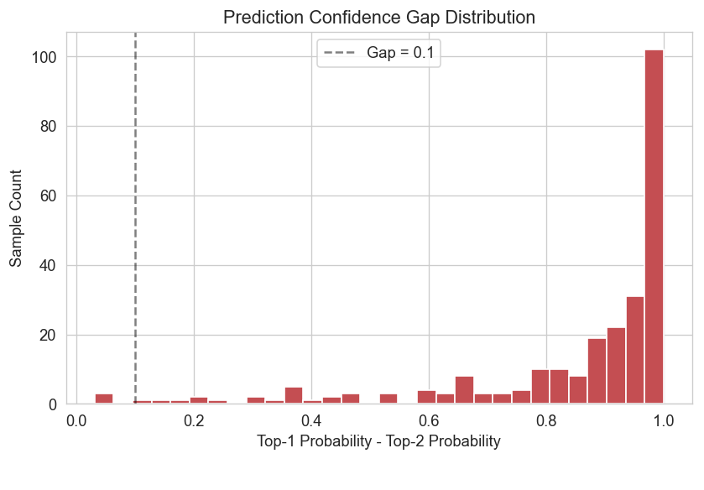
Uncertainty and Gray Areas in Age Rating
🔑 Key Observations
Uncertain samples cluster heavily at the boundary between 'Teen' and 'Mature 17+' categories. The gap between the top two predicted class probabilities is often negligible, indicating high ambiguity in content classification.
📋 Borderline Case Examples
Sample #239: Mature 17+ (0.443) vs. Teen (0.442).
These minuscule gaps (0.001) are not random errors but reflect genuine difficulty in applying rigid age labels.
Hotspot Zone
Teen ↔ Mature 17+
Min Probability Gap
0.001
💡 Practical Implications
Model uncertainty is a feature, not a bug. It can automate the flagging of borderline content for mandatory human review, improving fairness.
💡 Insight: Ambiguity stems from criteria, not just model limitations.
Notes:
By looking at the model's prediction probabilities, we identified the most uncertain cases. These are primarily concentrated between the 'Teen' and 'Mature 17+' ratings, where the model's confidence is very low. The Sample NO.239 shows that the difference between the top two predictions is minimal. This isn't just a model error; it highlights the inherent ambiguity in the rating criteria themselves. Therefore, model uncertainty can be a valuable tool to flag borderline cases for human review.

Slide 5
Structural Missing Values Are Informative Signals
🔍 Sentinel Values in Branching Logic
In questionnaires with conditional branching, values like '__INACTIVE__' or '__NONE__' are not random noise. They represent activated risk branches (e.g., a question about severe violence being inactive means no such content exists).
🧠 Core Analysis & Insight
Instead of discarding or imputing, we retained structural missing values. The L1 coefficients of the logistic regression model revealed that these sentinel features carry substantial positive/negative weights, indicating strong predictive power.
📚 Semantic Signal vs. Noise
In branching questionnaires, the absence or inactivity of a question is a direct semantic signal about the subject (e.g., no severe violence = lower risk). Treating these as mere missing data would erase critical context and degrade model accuracy.
Key Sentinel Values
__INACTIVE__
Logistic Reg L1 Coeff
± High Weight
💡 Strategic Recommendation
Retain sentinel values as categorical features; avoid mean/mode imputation to preserve the semantic information embedded in structural missingness.
💡 Note: Discarding these values would remove critical context for accurate risk classification.
Notes:
We found that structural missing values, like '__INACTIVE__' or '__NOT_APPLICABLE__', are not just noise. In a branching questionnaire, these values actually carry important semantic information. For example, if a question about severe violence is marked '__INACTIVE__', it indicates that the game doesn't contain such content, which is a strong signal for a lower age rating. Our model confirmed this by assigning significant weights to these sentinel values. Therefore, it's better to treat them as informative signals rather than simply imputing them.

Slide 6
Summary and Safety Recommendations
🔍Research Summary: Core Findings
🛡️Strengthen Validation & Human-in-the-Loop
For high-risk content, enforce strict validation and manual spot checks. Introduce human review specifically for borderline cases between "Teen" and "Mature 17+" to minimize misclassification errors.
Model Choice & Risk Drivers
L1 logistic regression outperformed others. High-risk ratings are dominated by violence, sexual content, drugs, and gambling, forming distinct feature combinations.
Redundancy & The Gray Zone Challenge
Questionnaires are highly redundant; key features suffice. The "Teen" and "Mature 17+" boundary is the most prominent gray area, with structural missing values holding predictive value.
📝Simplify Questionnaires & Avoid Overgeneralization
Eliminate low-information, redundant questions to reduce user burden. Exercise caution when drawing conclusions from categories with extremely small sample sizes to avoid misleading inferences.
Notes:
To summarize, this chapter has used our best model to analyze the key drivers of age ratings, identified significant redundancy in the questionnaire, pinpointed the 'Teen'/'Mature 17+' boundary as a major gray area, and highlighted the informative value of structural missing data. Based on these findings, we recommend strengthening validation for high-risk content, implementing human review for borderline cases, simplifying the questionnaire, and being cautious with small sample sizes. This analysis provides a data-driven foundation for improving age rating systems.

